Slide 2
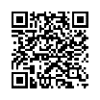
High School Counselors’ Association of Western New York
December Meeting
Buffalo State College: Teacher Education Unit
Campus Visit
December 10, 2021
KW
Guest Health Tracker
Notes:
Kathy Wood

Slide 3

Welcome!
Today’s Agenda
8:30-8:55 Check-in and Continental Breakfast
9:00-9:05 Welcoming Remarks- Dean Wendy Paterson
9:05-9:15 HSCA-WNY Business- Mark Veronica
9:15-9:45 HR Panel Discussion- Local Education Reps
9:45-10:00 Questions and Break
10:00-10:15 Buffalo State Admissions- Carolyn Murphy
10:15-10:45 Teacher Education Program Information- faculty
10:45-11:00+ Tour & Planetarium Visit (optional)
KW
Notes:
Wendy welcomes us and passes it to Mark Veronica

Slide 4

HSCA Business Meeting
Mark Veronica

Slide 5
Exploring Educator Preparation as a Career Path
Buffalo State- Why we are here
Panel- Need for teachers in WNY
Buffalo State- Admissions Office
Buffalo State- Program offerings
KD

Slide 6
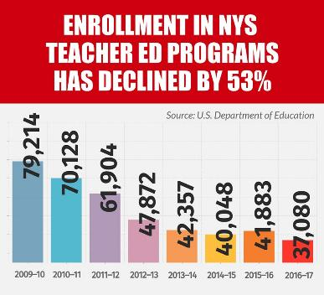
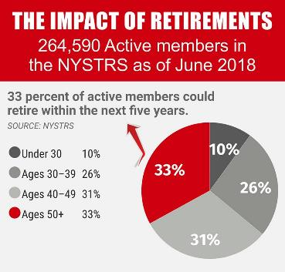
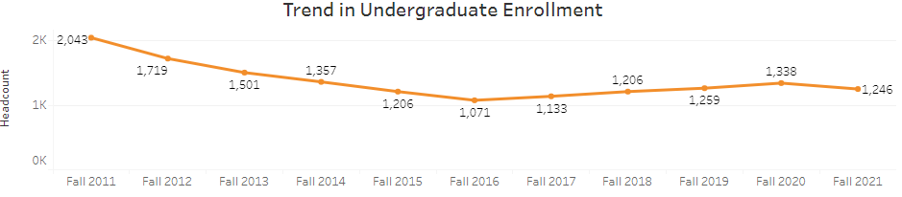
Why we are here today…
Double need.
Trends in Undergraduate Enrollment: Buffalo State Teacher Education Programs
KD

Slide 7
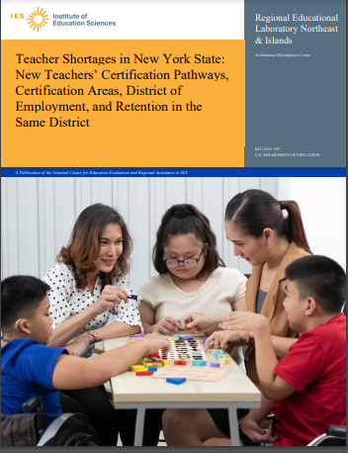
“New York State has faced geographically widespread and persistent teacher shortages…”
(IES, 2021, p. 2)
2021 NYS Shortage* Certification Areas:
Bilingual Education
Bilingual Special Education
Career and Technical Education
English Language Arts
Health education
Library Media Specialist
Literacy
Mathematics
Science
Special Education
*The geographic reporting areas include public schools in NYC, and the “Big Four” (Buffalo, Rochester, Syracuse Yonkers)
KD

Slide 8
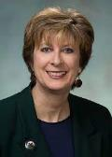
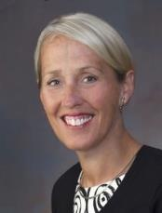
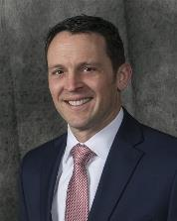
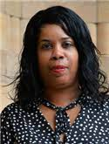
The Need for Teachers in WNY:
Local Perspectives
Moderator:
Dean Wendy Paterson
Buffalo State College, School of Education
30 minutes
Panel:
Kate Dust
EduKids Vice President,
Director of Education (retired)
Jeffery Richards
Assistant Superintendent for Human Resources
Kenmore Town of Tonawanda UFSD
Jamie Warren
Associate Superintendent of Human Resources, Buffalo Public Schools
KD
Notes:
Wendy will welcome panel members, state their name.
Opening statement from each person (1-2 mins)
-Introduce yourself
-Provide a brief statement about the need for teachers in your area
Suggested Questions:
In thinking about the role of high school counselors in facilitating college and career exploration for their students, what would you like the counselors to know about the field of teaching? How can they plant the seed that teaching may be a good job and worthwhile career for their students?
In your experience in hiring or supervising teachers, please share some characteristics that counselors can be on the lookout for when directing their students into the teaching field.
High School students are our future teachers, and they have a lot of options in Western New York when choosing an educator preparation program. Share your experience about the preparedness of Buffalo State graduates. What makes a Buffalo State graduate a great teacher?

Slide 9
Questions & Break
9:45-10:00
WP

Slide 10
Buffalo State
Admissions Office
10:00-10:15
CM

Slide 11
Buffalo State’s
Teacher Education Programs
What we offer.
&
Why we are "the place to come” for teacher preparation!
10:15-10:45
SB

Slide 12
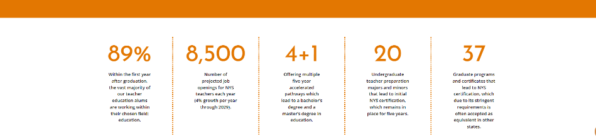
Areas of Study at BSC
Art Education | Exceptional Education (Special Education) | Physics Education
Business & Marketing Education | Elementary Education | Science Education
Career & Technical Education | English Education | Social Studies Education
Early Childhood Education | Math Education | Teaching English to Speakers of Other Languages (TESOL)
Educational Leadership | Music Education | Technology Education
SB
Notes:
Kathy Doody

Slide 13
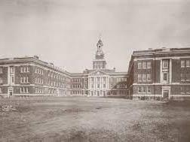


Characteristics to support why we are the “gold standard” in teacher preparation…
We offer:
Small class sizes & learning communities
Clinically rich experiences
Professional development
Mentoring
Awards & scholarships
Many ways to get involved
We are:
Service oriented
Globally aware
Award winning
Technology driven
Evidence based
Creative & innovative
Leaders
…and so much more!
SB
Notes:
Don’t elaborate on these yet. There are slides for each concept coming up.

Slide 14
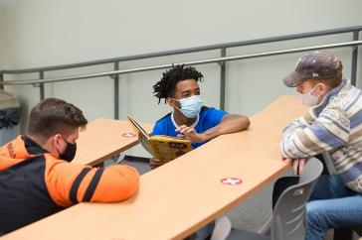
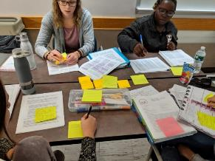
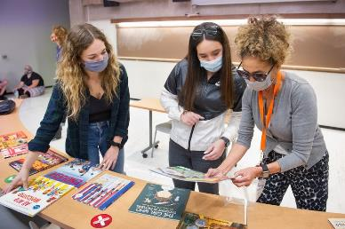
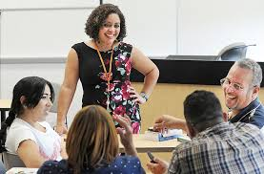
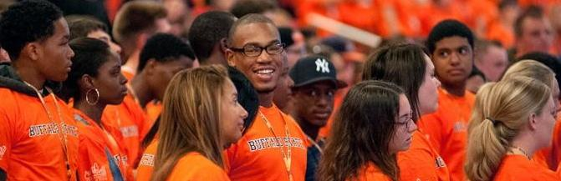
Small Class Sizes & Learning Communities
PdP
Notes:
Our teacher prep programs have no more than 20-24 students in the class.
For example, in science methods classes, frequent use of microlessons
Maybe mention the supports available too (like tutoring centers, peer coaches,
Mention TEU candidates have highest retention and 4 year graduation rates in college

Slide 15
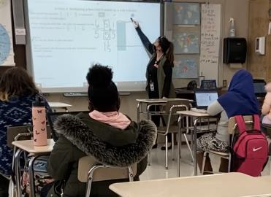
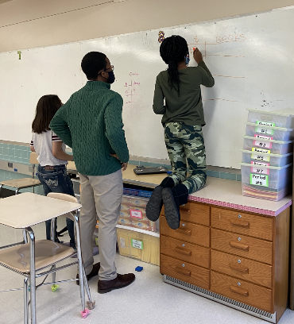
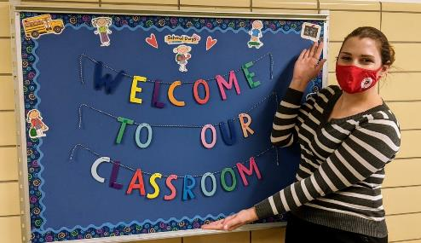
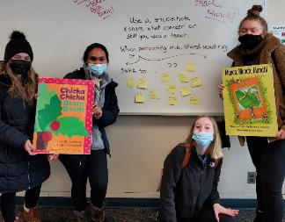
Clinically Rich
PdP
Notes:
Candidates get to work in schools early and often– in many cases starting in sophomore year with classes that take place at our partner schools.
Example from EDU 311: Teaching Reading and other Language Arts in the Elementary School Content focus: Literacy (reading, writing, speaking, and listening)
Minimum of 45 hours at PDS site Half semester on campus/ half at PDS school

Slide 16




















Districts / Charters / Agencies with Current PDS Relationships
2021-22 (24 schools)
PdP
Notes:
This year we have formal agreements with over 24 schools.
We have DISRICST agreements with BPS and Kenton. The rest are on a school by school basis.
NOTE, this does not include the schools where student teaching may also take place.

Slide 17
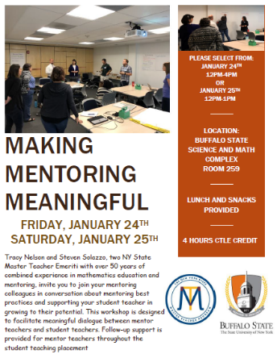
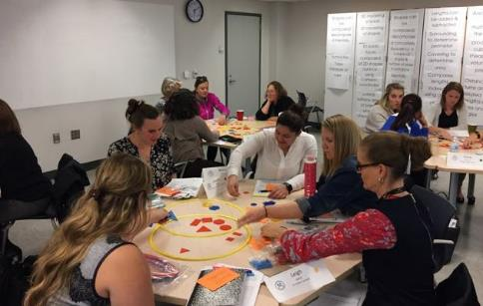
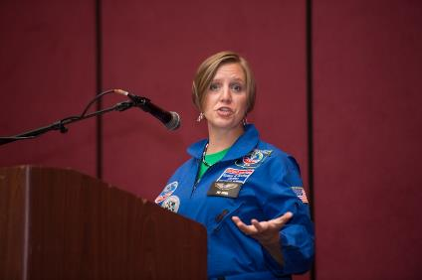
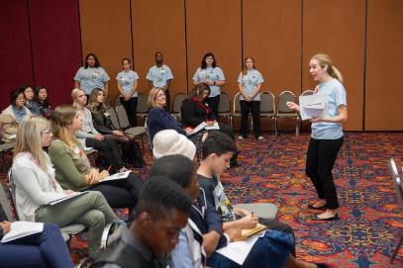

Professional Development & Mentoring
PdP

Slide 18
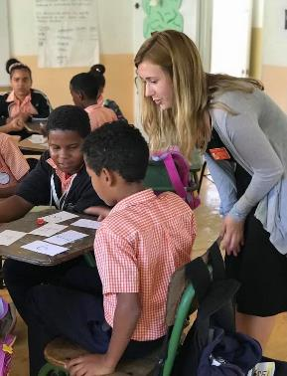

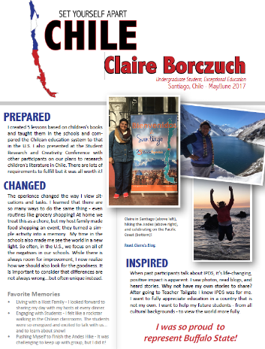

Globally Aware
PdP
Notes:
Global book hour
IPDS
Talk about international school (all secondary programs have opportunity to go and

Slide 19
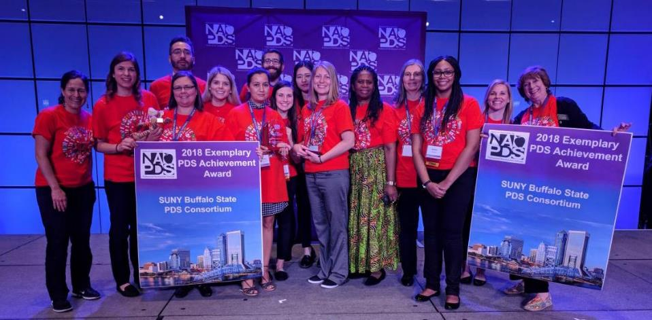
Award Winning
PdP
Notes:
Ipds award (ask tamara)
Student awards (presidents chancellors)

Slide 20
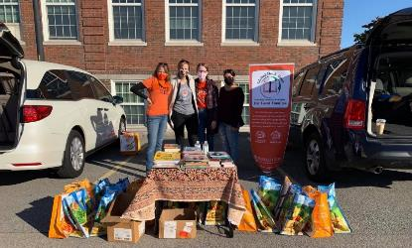
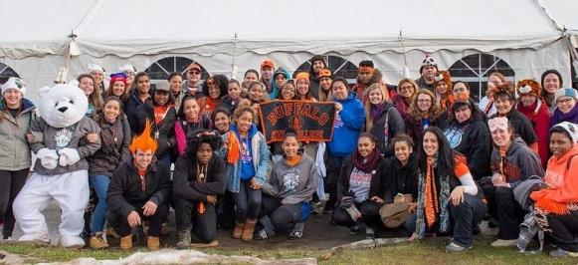
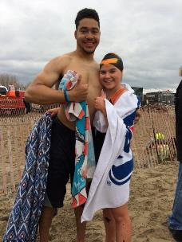
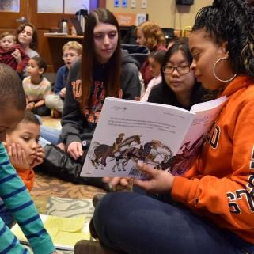
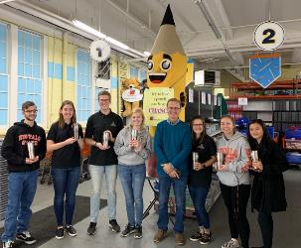
Service Oriented
KD

Slide 21
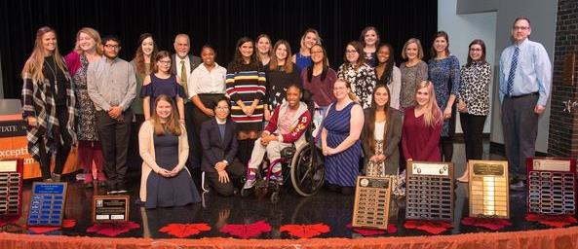
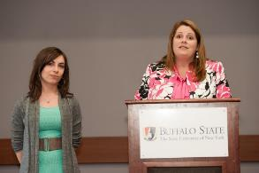
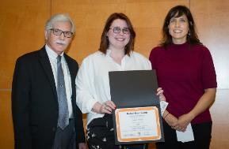
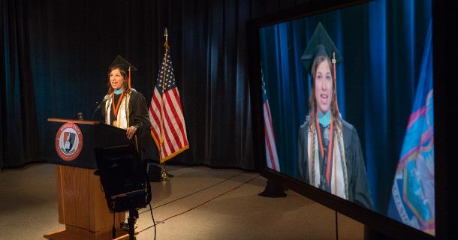

Awards & Scholarships
KD
KD
Notes:
Number of scholarships available
Honors program & honors dor
Over 57 scholarships available through CAPS earmarked for education majors
Scholarship portal that makes it easy

Slide 22


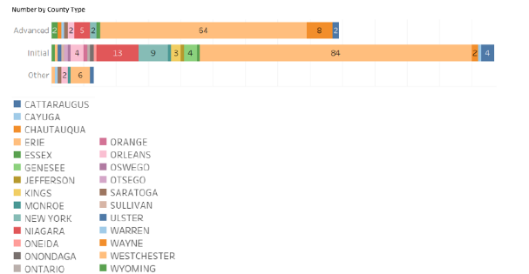
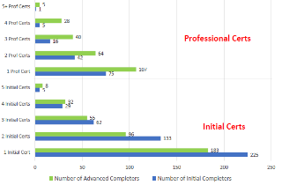
Resources to help students become employed & find jobs
Majority of graduates end up with 2-3 certifications:
Majority of graduates take jobs in Western New York
(Erie, Niagara, & Chautauqua Counties)
KD

Slide 23
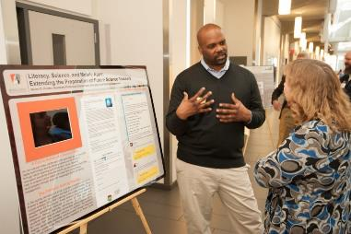
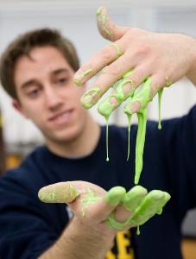
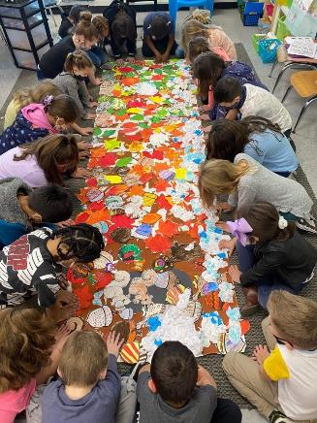
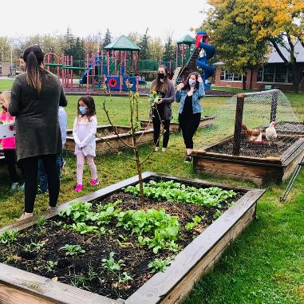
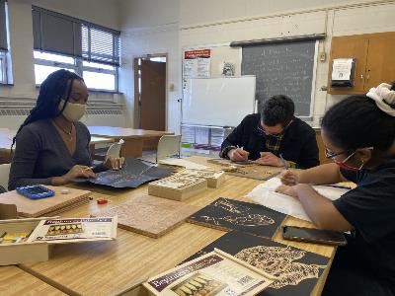
Creative & Innovative
DH

Slide 24
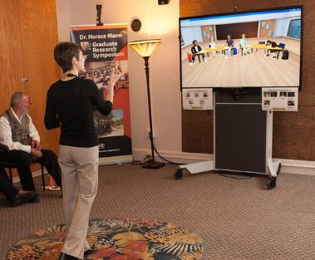
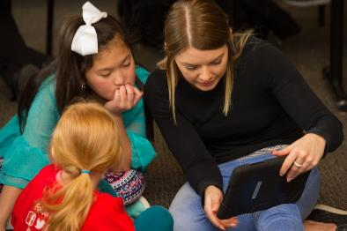
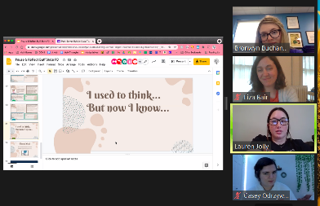


Technology Driven
DH
Notes:
Technology building, SAMC

Slide 25
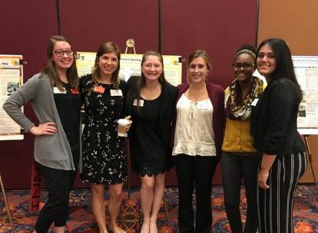
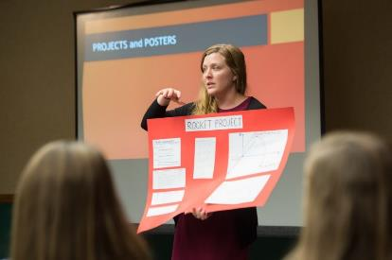

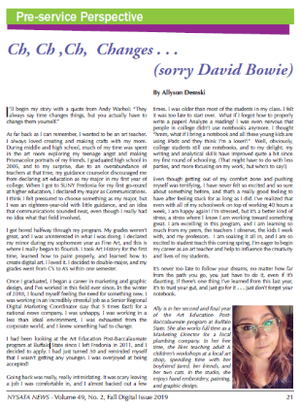
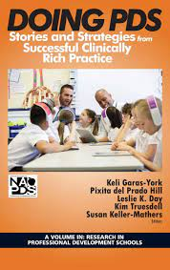
Evidence Based
DH
Notes:
Highlight student research ; conference presentations and opportunities for students to engage in scholarship (publications including chapters in PDS books)
e.g., each year we have between 30-50 education candidates participate in the annual student research and creativity conference on campus; Several are offered summer research fellowships each year (includes stipend to conduct research
Mary’s example of presenting w/ student and school personnel.

Slide 26




So many ways for education candidates to be involved:
SB
Notes:
Clubs and organizations
Art students did a wood cut NYS Art Teacher conference

Slide 27


We know how to have fun!
SB

Slide 28

and…..we loved dogs before it was cool!
SB

Slide 29

Thank you!
Planetarium Tour at 11am!
KW

